Slide 1
Shopping

Slide 2
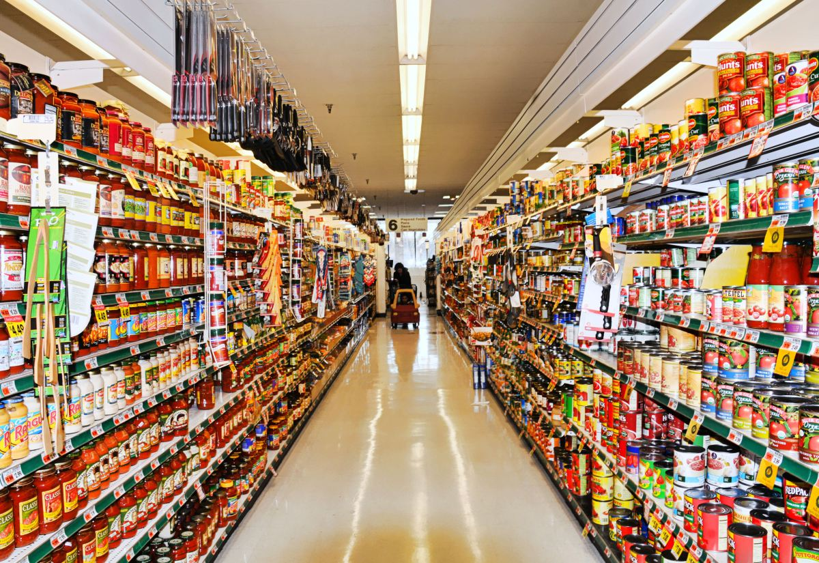
Department store- a large store containing many different departments, each of which deals in the sale of different goods or services.

Slide 3
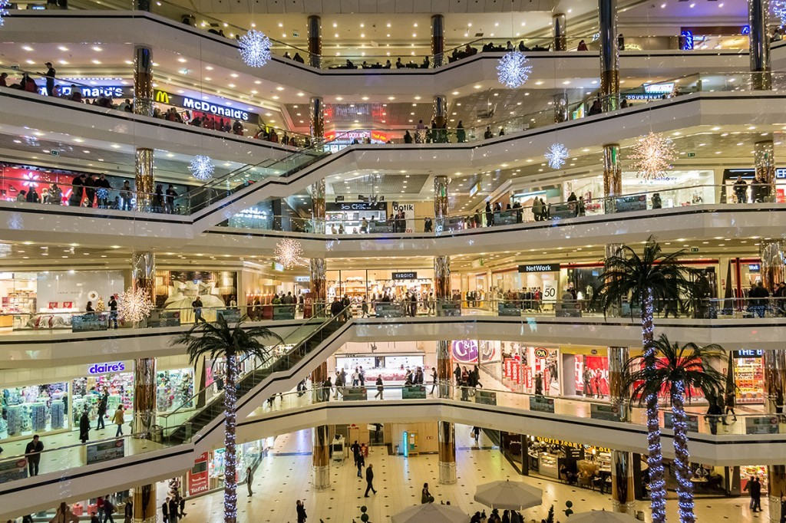
Shopping mall – shopping center

Slide 4
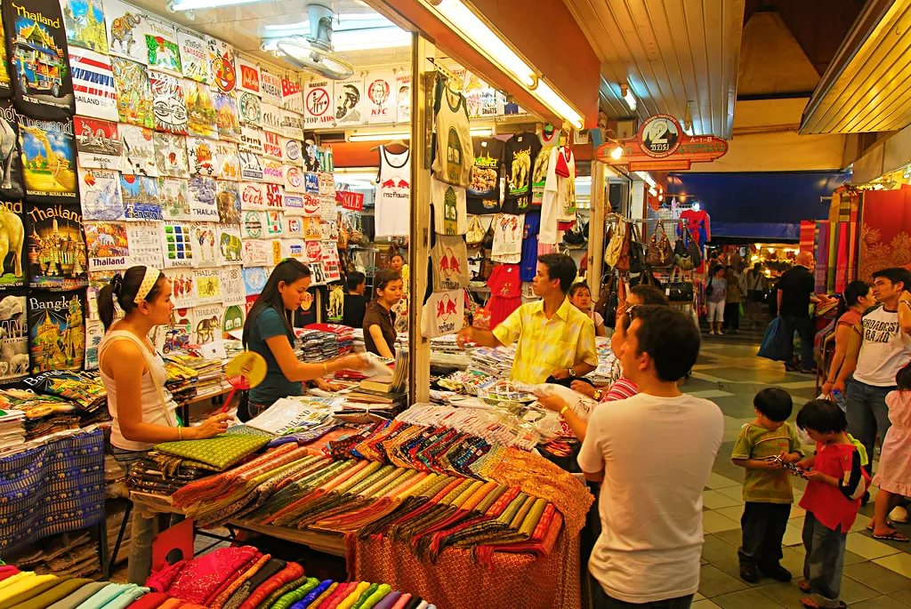
Bazaar – a marketplace, or assemblage of shops where goods are exposed for sale.

Slide 5
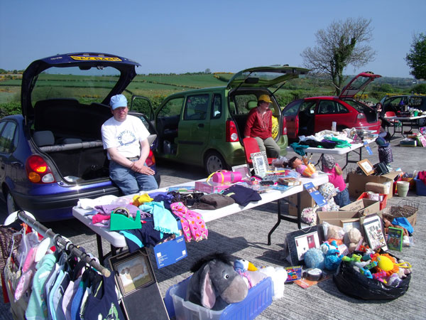
Car boot sale - an outdoor market at which people sell things from the boot (trunk) of their car.

Slide 6
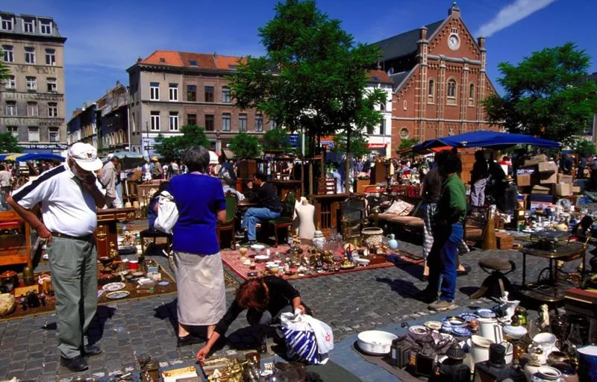
Flea market - a market where old or used goods are sold cheaply, usually outside

Slide 7
1 a
2 e
3 b

Slide 8
1 | clothes shop | 7 | optician’s
2 | hairdresser’s | 8 | post office
3 | butcher’s | 9 | florist’s
4 | bakery | 10 | fishmonger’s
5 | chemist’s | 11 | newsagent’s
6 | shoe shop | 12 | jeweller’s

Slide 9
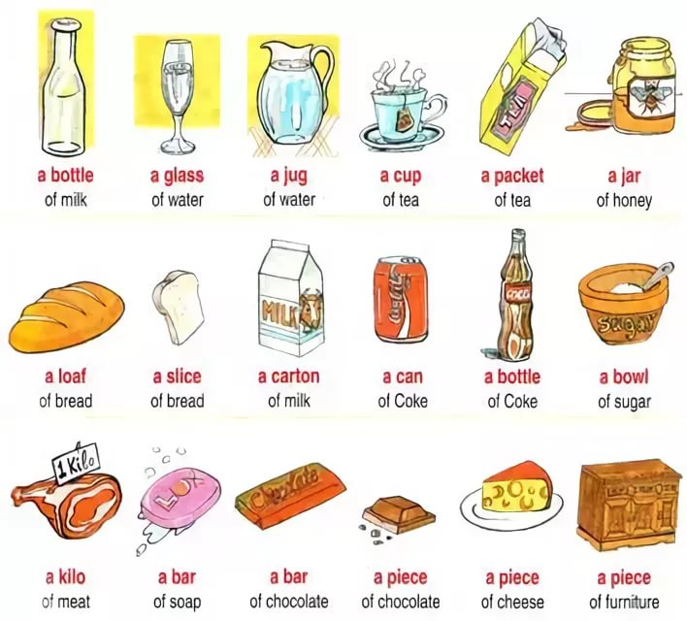

Slide 10
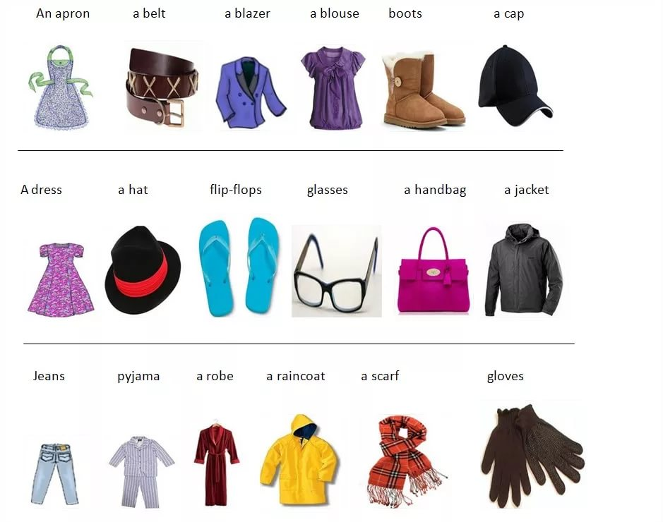

Slide 11
THANK YOU!

